Slide 1
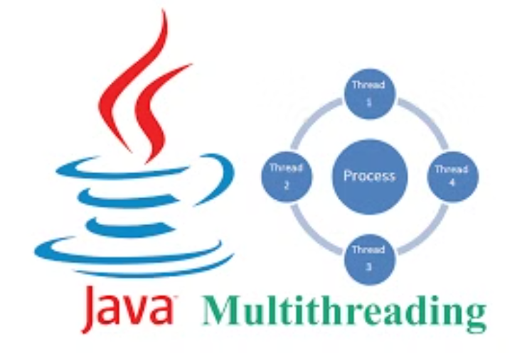
Multithreading in Java
CPU, Core, Program, and Process
Threads, Multitasking, and Multithreading
Context Switching
Thread Lifecycle & States
Creating Threads in Java
Priority & Synchronization
Reentrant Lock
Thread Communication
Executors Framework

Slide 2
CPU, Core, Program, and Process
CPU
Core
Program
Process
The CPU executes instructions from programs.
A core is a processing unit within a CPU.
A program is a set of instructions for a task.
A process is an instance of a running program.

Slide 3
Threads, Multitasking, and Multithreading
Thread
Multitasking
Multiprocessing
Smallest unit of execution within a process.
OS runs multiple processes simultaneously.
Multiple processors executing tasks.
Multithreading
Multiple threads execute within a process.

Slide 4
Context Switching
Context switching is the process of saving the state of a currently running process or thread and restoring the state of another process or thread so that execution can continue.
Process Context Switch
Thread Context Switch
Context Switching
Slower, more overhead.
Faster, less overhead.
Switching between processes is more expensive than switching between threads.

Slide 5
Thread Lifecycle & States
New
1
Thread is created but not yet started.
2
Runnable
Thread is ready to run, awaiting CPU.
Running
3
Thread is executing its task.
4
Waiting
Thread is waiting for another thread.
Blocked
5
Thread is waiting for a lock.
6
Terminated
Thread has completed execution.

Slide 6
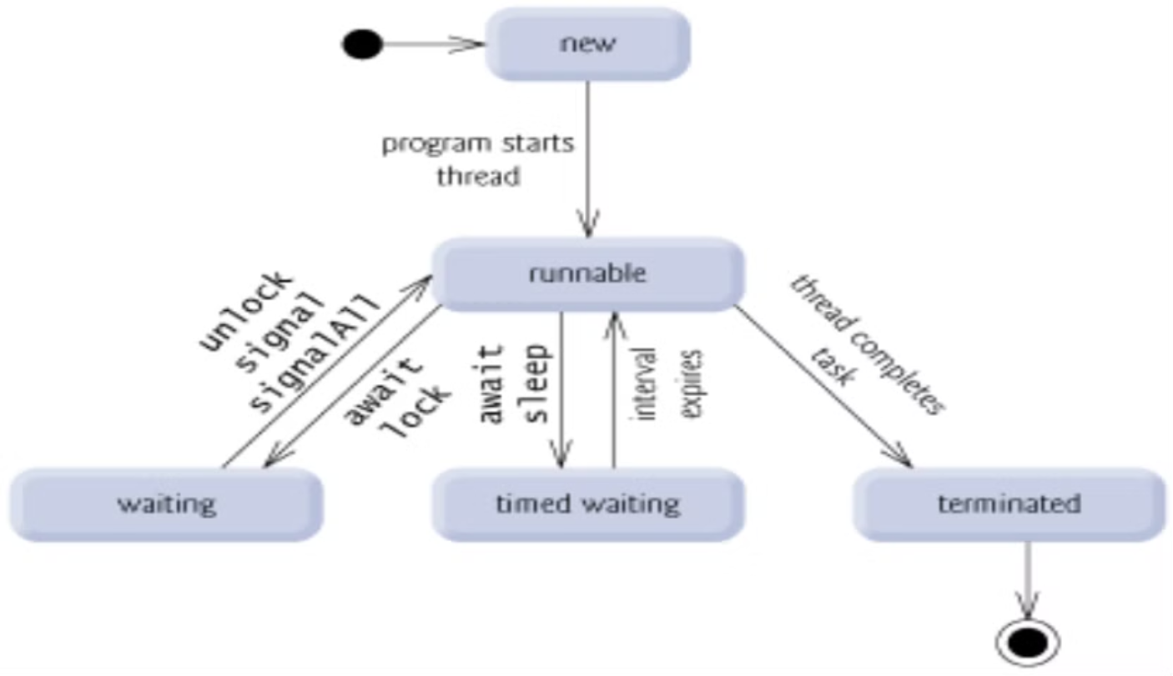
Thread States

Slide 7
Creating Threads in Java
Extending Thread
Implementing Runnable
Create a class that extends the Thread class. Override the run() method with your task's code.
Create a class that implements the Runnable interface. Define the task within the run() method.
Simple to implement.
More flexible approach.
Inherits thread functionality.
Allows extending other classes.
Limited, can't extend other classes.
Recommended for most cases.

Slide 8
Extending the Thread Class
To create a thread by extending the Thread class, you need to:
Create a class that inherits from Thread.
Override the run() method, which contains the code that will be executed by the thread.
Create an instance of your class and call the start() method to begin execution.
Create Class
1
Extend java.lang.Thread.
2
Override run()
Implement the thread logic.
Create Instance
3
Instantiate your class.
4
Call start()
Begin thread execution.

Slide 9
Implementing the Runnable Interface
To create a thread by implementing the Runnable interface, you need to:
Create a class that implements java.lang.Runnable.
Implement the run() method, which contains the code to be executed by the thread.
Create an instance of your class.
Create a Thread object, passing your Runnable instance to the Thread constructor.
Call the start() method of the Thread object.
Create Class
1
Implement the Runnable interface.
2
Implement run()
Implement thread logic inside the run() method.
Create Instance
3
Instantiate your class to prepare the thread.
4
Create Thread
Pass Runnable instance to the Thread constructor.
Call start()
5
Begin thread execution with the start() method.

Slide 10
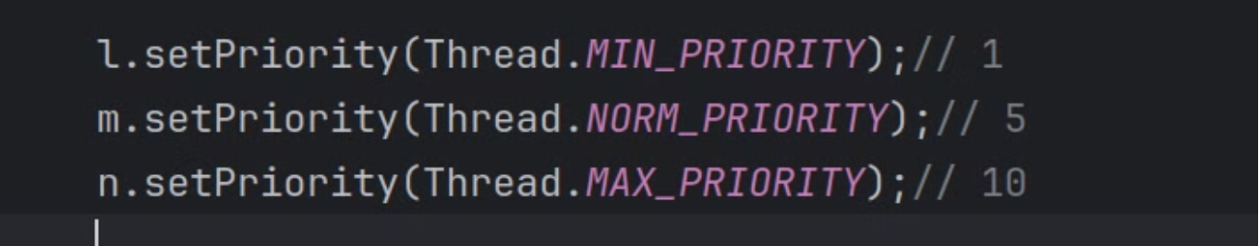
Priority Thread
Each thread has a priority. Priorities determine the order of execution.
Set Priority
Get Priority
Range
Use setPriority() method.
Use getPriority() method.
From 1 to 10, 10 is highest.

Slide 11
Thread Synchronization
It ensures data integrity by managing access to shared resources.
Mutual Exclusion
Monitors
Only one thread can access the resource at a time. Prevents multiple threads from simultaneously reading or writing.
Controls access to objects with synchronized methods. Ensures proper locking and unlocking of resources.

Slide 12
Reentrant Lock
lock()
unlock()
Acquires the lock, blocking until available.
Releases the lock held by the current thread.
A Reentrant Lock in Java allows a thread to acquire the same lock multiple times. It prevents deadlock, offering flexibility over synchronized. Use ReentrantLock from java.util.concurrent.locks for advanced thread coordination.

Slide 13
Thread Communication
1
wait()
2
notify()
3
notifyAll()
It pauses the current thread execution. It releases the lock on the object.
It wakes up a single thread waiting on the object's monitor. Resumes the execution of one waiting thread.
It wakes up all threads waiting on the object's monitor. Notifies all waiting threads to acquire the lock.

Slide 14
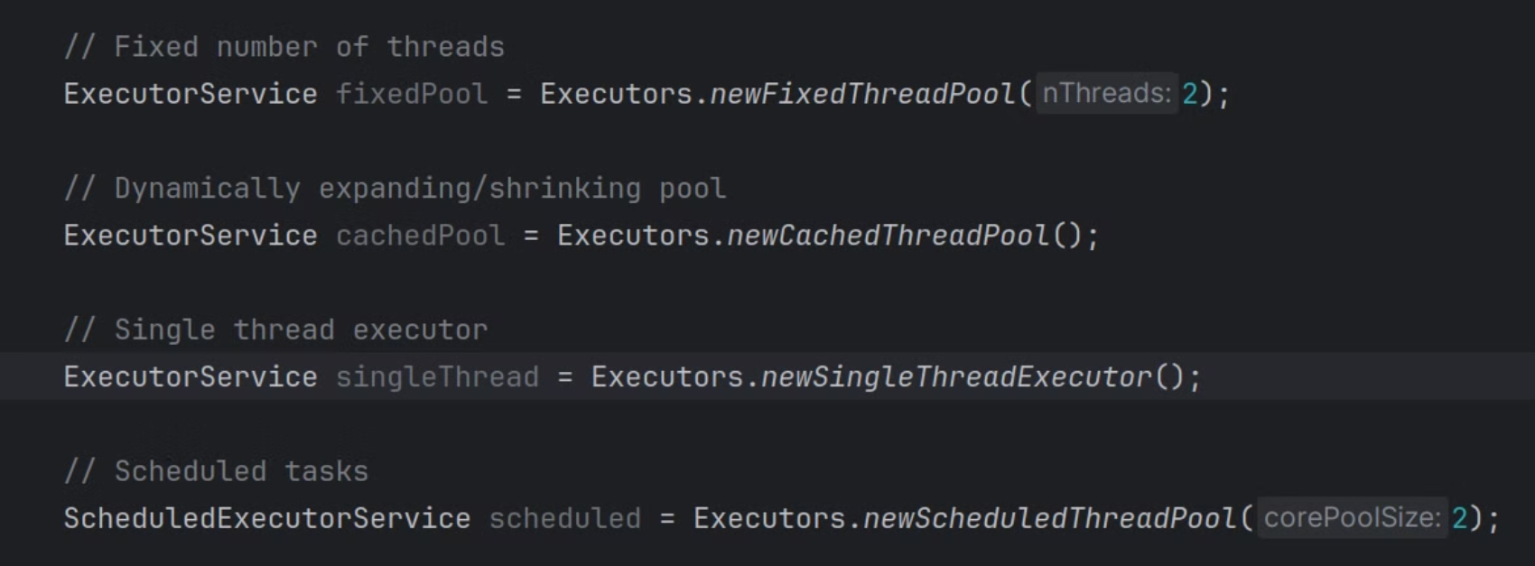
Executors Framework
Controle the number of execute threads

Slide 15
GitHub Repo
Multi-Threads: https://github.com/Abdelrahman-Magdii/MultiThreads.git
Thread Communation: https://github.com/Abdelrahman-Magdii/Thread-Communation.git

Slide 16
Thanks

